Slide 1
Old Version
User
card
email
social
info
policy
email

Slide 2
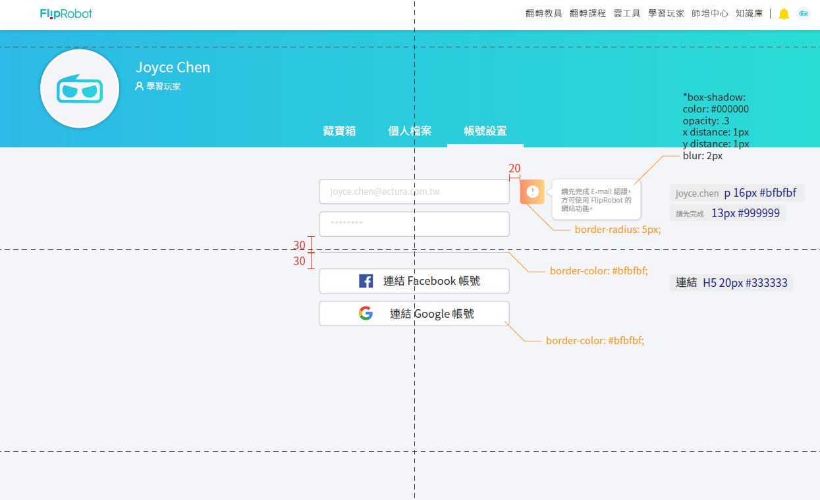

Slide 3
account email
Account
social
social email
Account id | User id | role
1 | 1 | admin
2 | 1 | teacher
3 | 1 | student
2
Membership
1
User
card
user email
info
policy

Slide 4
account
id | email | Card id
1 |  | 1
2 |  | 2
3 |  | 3
account email
Account
membership
Account id | User id | role
1 | 1 | admin
2 | 1 | teacher
3 | 1 | student
Membership
User
card

